Slide 1

Data Handling and Visualization for Business Intelligence

Slide 2


Abstract
In today’s business environment, organizations generate a large amount of data from daily operations such as sales, customer interactions, finance, and marketing activities. However, raw data is often incomplete, unorganized, and difficult to understand, which makes decision making challenging. This project focuses on data handling and visualization techniques to support effective business intelligence. The data handling process includes collecting data, cleaning missing and duplicate values, transforming data into a structured format, and validating it for accuracy. After preprocessing, the data is analyzed to identify important business patterns and performance indicators. Data visualization techniques such as bar charts, line graphs, pie charts, and heatmaps are used to present insights in a clear and easy-to-understand manner. These visual representations help decision makers quickly understand trends, compare performance, and identify problem areas. The project demonstrates how proper data handling combined with effective visualization improves decision-making accuracy, reduces manual effort, and supports data-driven business strategies. Overall, this project highlights the importance of business intelligence systems in transforming raw data into meaningful insights for organizational growth.

Slide 3


Introduction
Modern businesses generate large volumes of data from sales, customers, finance, and operations.
Raw data is often unstructured, inconsistent, and difficult to interpret.
Business Intelligence (BI) helps convert raw data into meaningful information.
Effective data handling ensures data accuracy, reliability, and usability.
Data visualization presents insights in graphical form for easy understanding.
This project focuses on integrating data handling and visualization to support business decision making.

Slide 4

Objectives
To collect business data from multiple sources.
To clean and preprocess raw business data.
To transform data into an analyzable format.
To visualize business metrics using charts and dashboards.
To support data-driven business decision making.
To improve understanding of business trends and performance.

Slide 5
Problem Statement
Business data is often scattered across different systems.
Raw data contains missing values, duplicates, and inconsistencies.
Manual analysis of large datasets is time-consuming and error-prone.
Traditional reports fail to provide real-time insights.
Decision makers struggle to interpret complex data quickly.
Hence, there is a need for an efficient data handling and visualization system for business intelligence.

Slide 6

Module Data Handling and Visualization for Business Intelligence

Slide 7
Module Overview
Collects structured business data from files or databases.
Performs data cleaning and preprocessing.
Transforms and aggregates data for analysis.
Analyzes key performance indicators (KPIs).
Visualizes data using graphs and dashboards.
Provides insights to support business decisions.

Slide 8
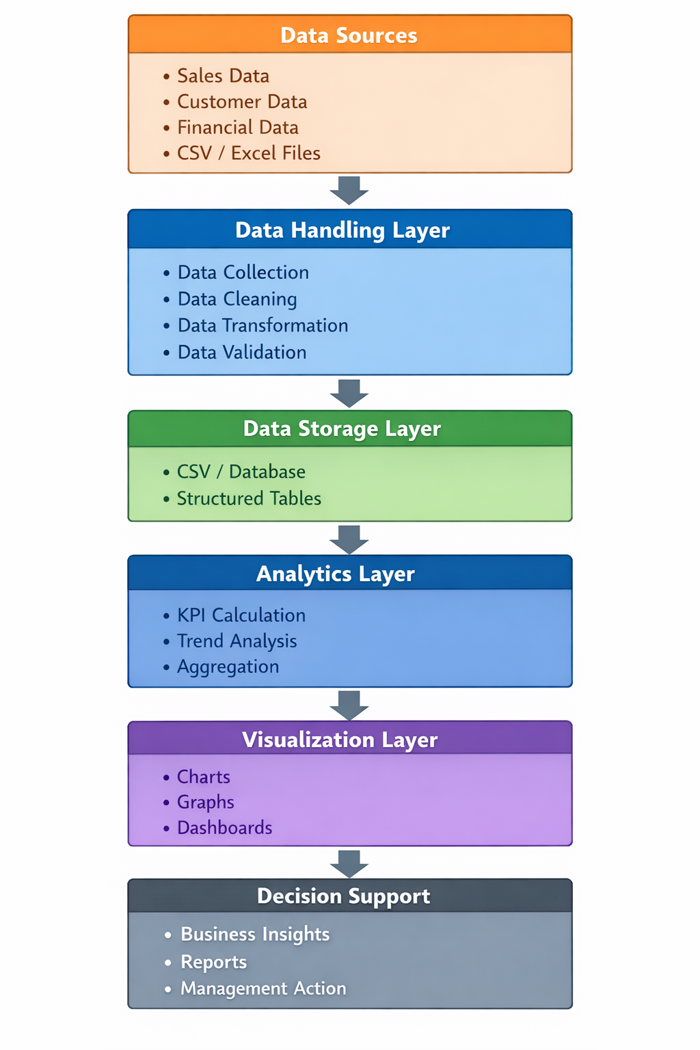
System Architecture

Slide 9
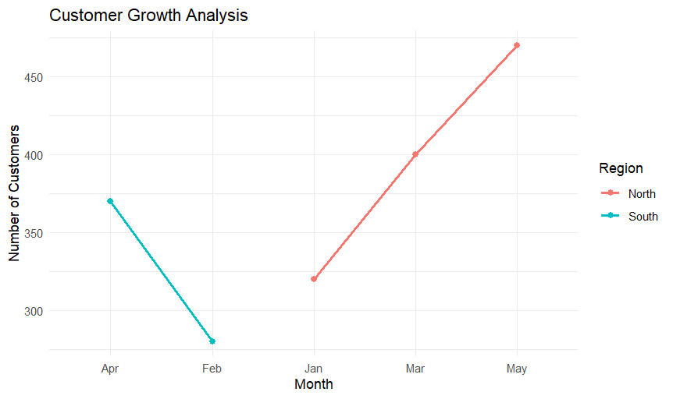
Output

Slide 10
Applications
Sales and revenue analysis.
Customer behavior and segmentation analysis.
Financial performance monitoring.
Inventory and supply chain management.
Marketing campaign performance analysis.
Management reporting and strategic planning.

Slide 11
Future Scope
Integration with real-time data sources.
Incorporation of machine learning for predictive analytics.
Cloud-based BI solutions for scalability.
Advanced interactive dashboards.
Integration with big data technologies.
Mobile-friendly BI dashboards.

Slide 12
Results & Discussion
Clean and structured business datasets are obtained.
Key business metrics and trends are clearly identified.
Interactive visualizations improve data interpretation.
Faster and more accurate business decisions are enabled.
Improved understanding of organizational performance.

Slide 13
Conclusion
The project successfully demonstrates effective data handling techniques.
Visualization simplifies complex business data into actionable insights.
The system improves accuracy, speed, and quality of decision making.
Data handling and visualization together form the foundation of business intelligence.
The project provides a scalable and practical solution for real-world business analytics.

Slide 14
References
Han, J., Kamber, M., & Pei, J., Data Mining: Concepts and Techniques, 3rd Edition, Morgan Kaufmann, 2012.
Turban, E., Sharda, R., Delen, D., & King, D., Business Intelligence: A Managerial Perspective on Analytics, Pearson Education, 2018.
Few, S., Information Dashboard Design: Displaying Data for At-a-Glance Monitoring, Analytics Press, 2013.
Provost, F., & Fawcett, T., Data Science for Business, O’Reilly Media, 2013.
Wickham, H., ggplot2: Elegant Graphics for Data Analysis, Springer, 2016.

